Slide 1
Manual vs. Automated Software Testing

Slide 2

Deshal Weerasinghe
BSc. (IT) – Curtin University, 2009
MBA – PIM (University of Sri Jayewardenepura), 2014
ISTQB Certified Advanced Test Manager
10+ Years Industry experience as a QA Engineer and Team Lead
Working as Technical Lead at WSO2 Inc.
Visiting Lecturer at SLIIT

Slide 3
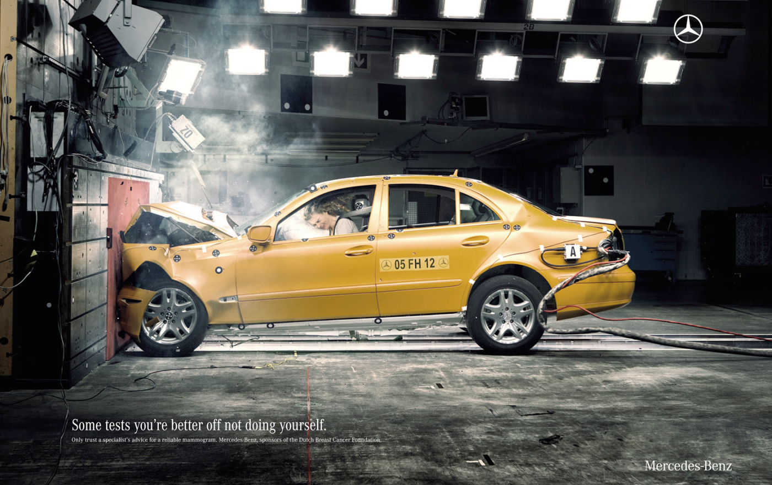

Why do we ‘Test’ Things?

Slide 4
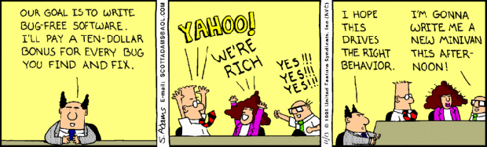
Why Test Anything?
To know whether it is ‘working’
To know whether it ‘fits the purpose’
To know whether ‘something is wrong’ with it
To know ‘how it fails’, when it fails

Slide 5
Why Software Should be Tested?
Humans develop software
They may make errors/ mistakes
These errors built in to software are ‘defects’
The defects will cause the software to ‘fail’
The failures cause damages – financial and otherwise
Testing helps to identify these defects/ failures before the software is used by customers
One reason to test software is to reduce (not eliminate) defects
Additionally, testing is done in order to ensure the right thing is build

Slide 6
We Test Software to Gather Information
“I am only a good tester when I don't care if it works or not, only that I provide the information needed to confirm or deny that it works.”
- B. Hal Metz (Test Lead Consultant, Fusion Alliance)

Slide 7
How Software is Tested
Identify test context/ conditions
Prepare test scenarios/ test cases
Use test design techniques
Test in different levels of software development
Use multiple test types
And different test execution types to suit the task at hand
Report test outcomes

Slide 8
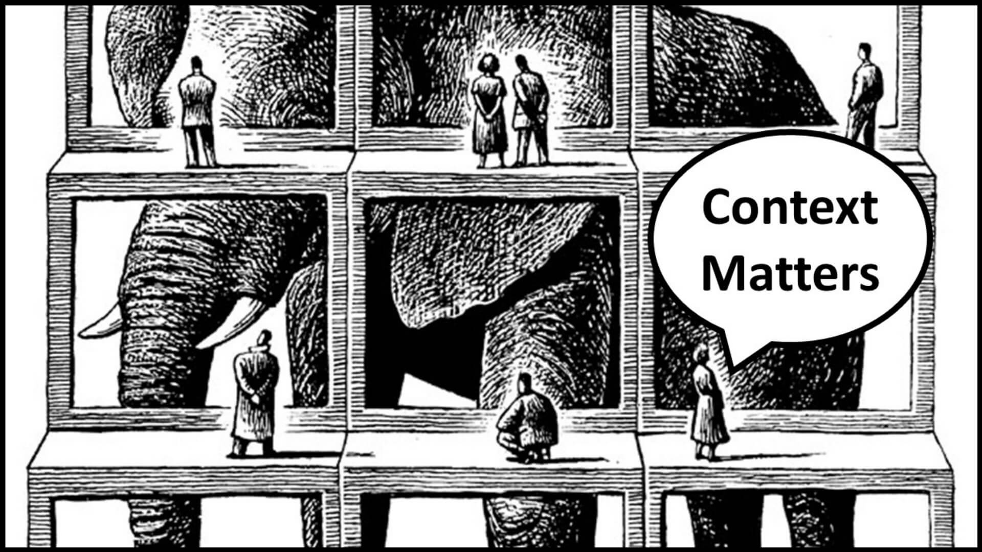
Test Context
Identify the type of application under test – the context
Eg. Bank ATM application vs. mobile email client
Identify what features of the application to test
Eg. Web front end vs. API

Slide 9
Test Scenarios & Test Cases
A test scenario in general is an end-to-end flow of inter-related events
Eg. Log in > edit profile > change profile picture > save
A test case defines specific inputs, operations and outputs of a selected test scenario or a part of it
Use test design techniques to make the test scenarios efficient and effective

Slide 10

Components of a Typical Test Case
Summary
Description
Pre-conditions
Post-conditions (optional)
Test data (optional)
Test Steps
Expected Results/ Outputs

Slide 11
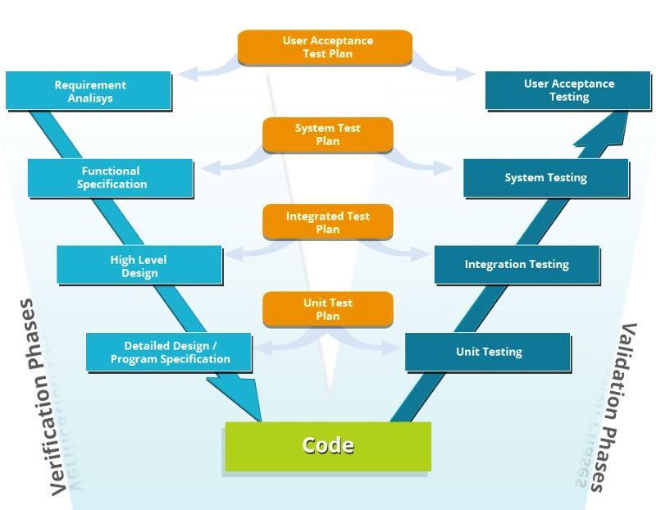
Test Levels

Slide 12

Test Types
Functional Tests
Non-functional Tests
Performance, load, stress, usability, accessibility
Structural
‘White-box’ Testing
Change-related Tests
Regression/ retesting

Slide 13
Test Execution Types
Build Verification Tests (BVT)
Verify whether all basic functionalities of a selected application works after creating a new build with changes
Smoke Tests
Verify whether a new build is stable enough to continue the rest of the testing
Functionality Verification (’Progression’)
Verify one or more selected functionality after initial implementation or making changes
Regression Test
Verify a functionality or related functionality to assess the impact of changes made
Re-testing
Test everything once again

Slide 14

Test Outcomes Reporting
Bugs/ defects
Change requests
Status reports
Periodic health-checks
Test coverage reports

Slide 15
How Software is Tested
Identify test context/ conditions
Prepare test scenarios/ test cases
Use test design techniques
Test in different levels of software development
Use multiple test types
And different test execution types to suit the task at hand
Report test outcomes

Slide 16


Slide 17
The Seven Principles of Testing from ISTQB
Testing shows presence of defects
Exhaustive testing is impossible
Early testing
Defect clustering
Pesticide paradox
Testing is context-dependent
Absence of errors fallacy

Slide 18
Manual Testing
A person executes test cases manually
Perform input tasks
Observe outputs/ outcomes
Report observations
Requires the tester to be knowledgeable about the software and often the domain
At least the first round of testing of a new application should be done manually

Slide 19
How Testing is done in a Typical SW Project
Requirements
Implementation
Testing
Release
Maintenance
Unit Testing
Dev Team Implements
Code Reviews
Product Owner/ Customer Provides
Manual Testing
QE Team Designs Tests
Automation
Regression
BVT/ Health-checks

Slide 20
Automated Testing
A tool executes test cases automatically
Perform inputs
Verify outputs/ outcomes (compare with expected outcomes – ‘assert’)
Report (generate matrices, share with stakeholders)
More suitable for a matured application, which delivers frequent updates/ changes

Slide 21
Why Testing should be Automated?
Manual testing is time-consuming (time = money!)
Higher error margin associated with repetitive manual test execution
Manual testers can focus more on exploratory tests rather than repetitively executing same set of tests

Slide 22
What should be Automated?
Tests that require frequent execution
Eg. Daily executions of BVTs/ Health-checks
Test cases that require higher precision in execution
High-frequency concurrent user actions
Tests that are difficult to perform manually
High number of multi-user tests (performance)

Slide 23
How Testing is Automated?
Tool Selection
Define scope & Plan
Select a tool based on the application type, domain etc.
Design & Implementation
What to automate (scenarios, data, reusable items)
Test Execution
Create scripts, execution methods, schedule, pre/ post conditions
Maintenance
Direct/ local execution
Scheduled/ CI-CD based execution
Carry out updates, changes and bug-fixes

Slide 24
Advantages of Test Automation
Reduced execution time
Convenient way of executing repetitive tests frequently
Minimal human intervention required for execution
Easy to maintain consistency of tracking and reporting
Helps to improve test coverage
Less error-prone than manual testing

Slide 25
Common Test Automation Tools and Frameworks
Selenium
Junit
TestCafe
Gauge
SoapUI
Jmeter
Postman
TestComplete
Appium
Cypress

Slide 26
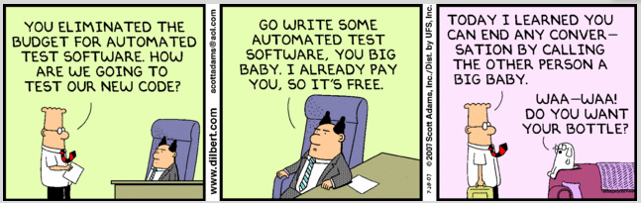
Custom Test Automation Frameworks

Slide 27
Overheads of Test Automation
Requires test designers to be more tech-savvy
May require higher setup and maintenance costs
No one-tool-fits-all type of solutions
Maintenance of custom test automation frameworks

Slide 28
Practical Examples
Hardware + Software App : the Kiosk
POC app development
Automating a capital market application
Fast delivery of quick-fixes to users
How a new application test strategy evolves with the application lifecycle

Slide 29
That’s all! Thank You!
Want to raise a question later? Send to deshal.lec@gmail.com

